Slide 1
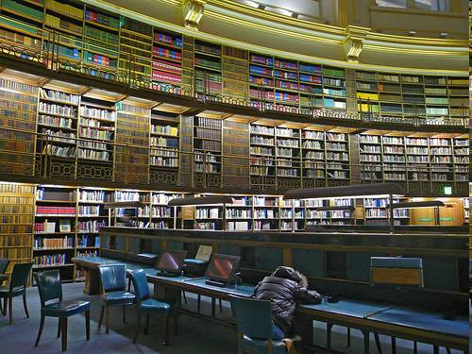



What collecting institutions can do
Jessica Coates
Project Manager, Creative Commons Clinic
GLAM-WIKI
August 2009
culture exhausts anyone by procsilas, http://www.flickr.com/photos/procsilas/343784334/
CRICOS No. 00213J

Slide 2
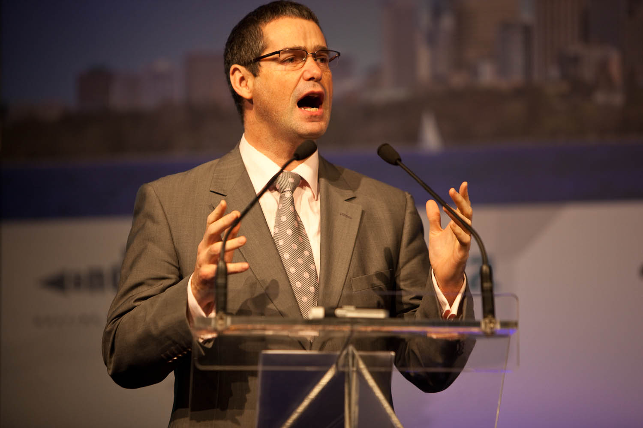
The Problem
the internet makes much more possible
but only if we have content to work with
v hard for Australians to find legal, reliable, safe sources of local material for remixing
Stephen Conroy by Kim Davies (kjd), at http://www.flickr.com/photos/kjd/3649021240/in/set-72157619883661663/
under a Creative Commons Attribution licence http://creativecommons.org/licenses/by/2.0/deed.en
Notes:
The open access movement is in a better place than its ever been before, as far as gaining ‘mainstream’ acceptance and being adopted by large players
There have, of late, been lots of official statements endorsing open access – from the OECD, from Venturous Australia etc

Slide 3
The Problem
the internet makes much more possible
but only if we have content to work with
v hard for Australians to find legal, reliable, safe sources of local material for remixing
The Solution
our collections have the potential to fill this gap
sure there are costs, but its less expensive than making it all from scratch
Stephen Conroy by Kim Davies (kjd), at http://www.flickr.com/photos/kjd/3649021240/in/set-72157619883661663/
under a Creative Commons Attribution licence http://creativecommons.org/licenses/by/2.0/deed.en
Notes:
The open access movement is in a better place than its ever been before, as far as gaining ‘mainstream’ acceptance and being adopted by large players
There have, of late, been lots of official statements endorsing open access – from the OECD, from Venturous Australia etc

Slide 4

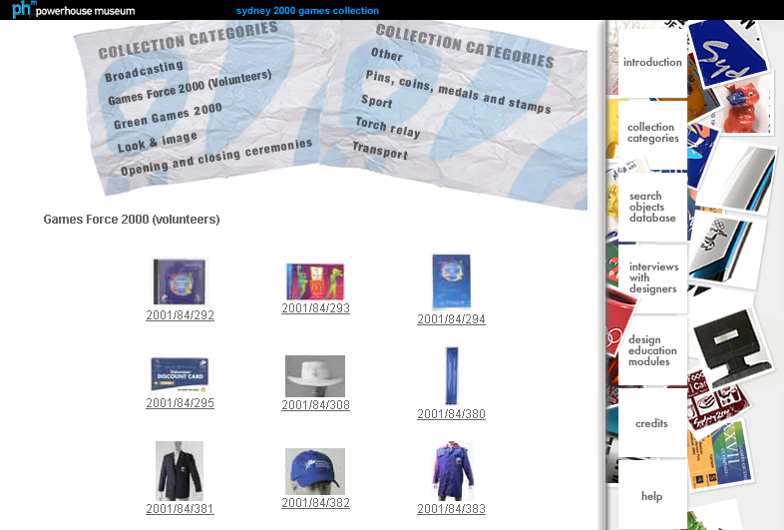
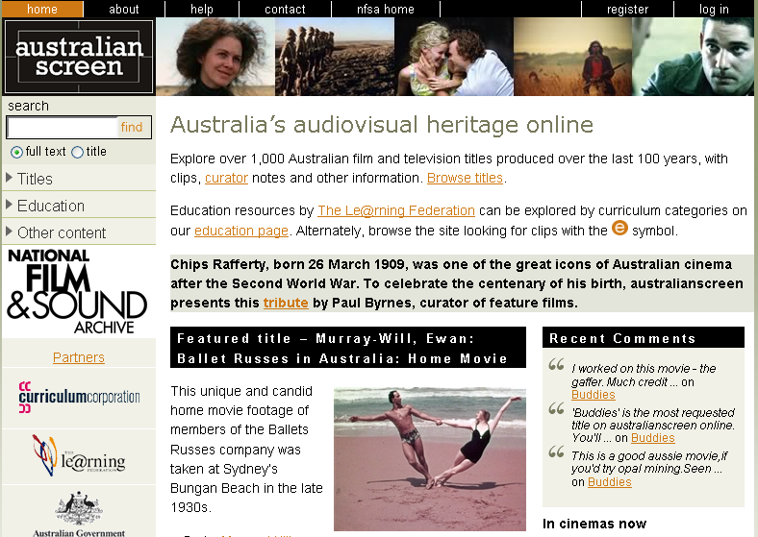
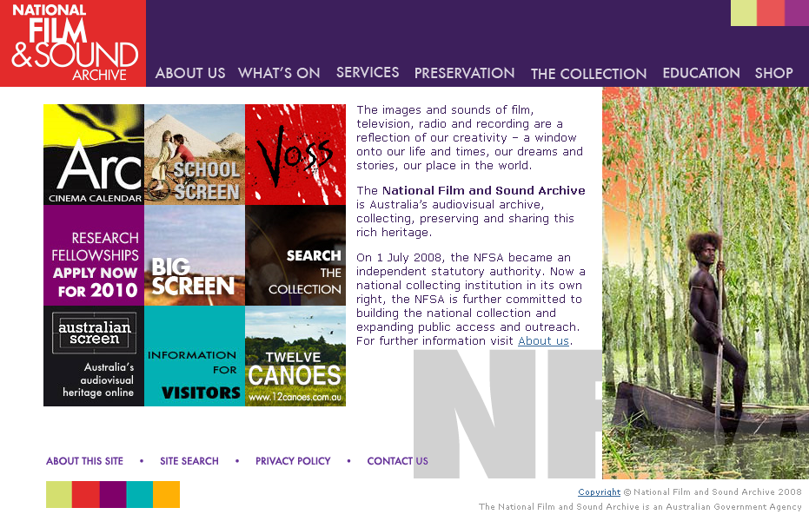
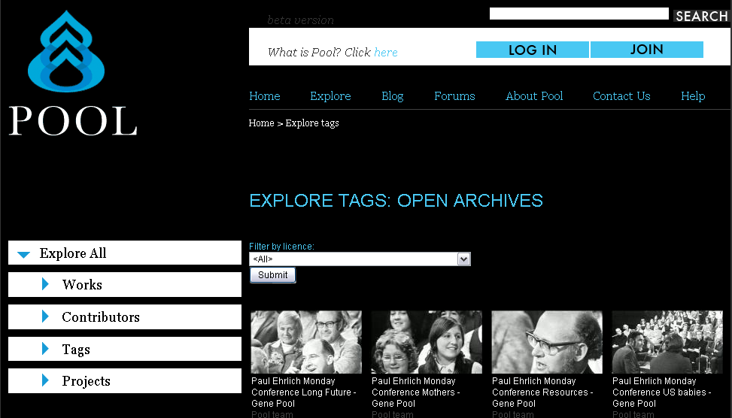
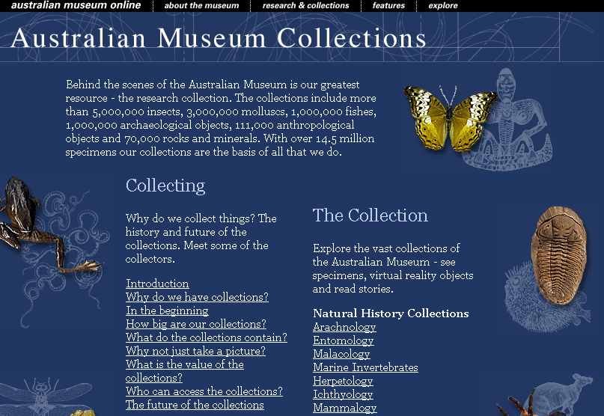
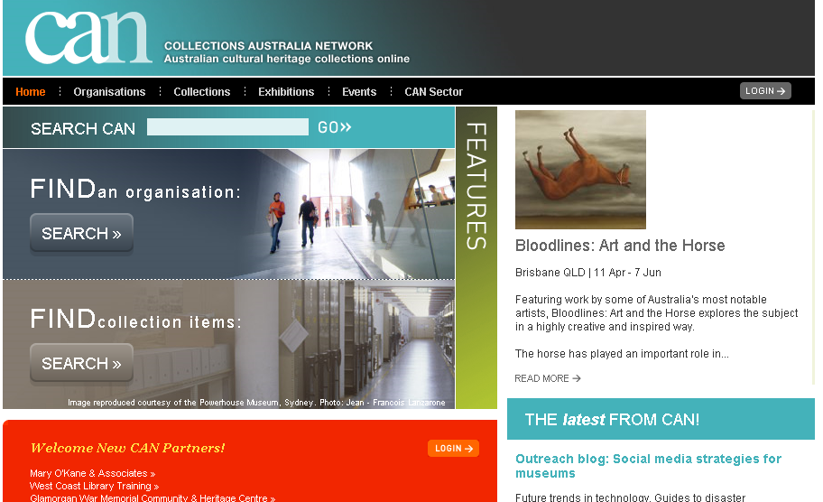



it’s already happening
CRICOS No. 00213J
Notes:
The open access movement is in a better place than its ever been before, as far as gaining ‘mainstream’ acceptance and being adopted by large players
There have, of late, been lots of official statements endorsing open access – from the OECD, from Venturous Australia etc

Slide 5
it’s already happening
it’s still illegal to use most of this material without going through cumbersome clearance processes
CRICOS No. 00213J
Notes:
The open access movement is in a better place than its ever been before, as far as gaining ‘mainstream’ acceptance and being adopted by large players
There have, of late, been lots of official statements endorsing open access – from the OECD, from Venturous Australia etc

Slide 6
it’s already happening
it’s still illegal to use most of this material without going through cumbersome clearance processes
This is particularly frustrating when the material is in the public domain, or it’s funded and owned by tax payers, or there’s a charge attached.
CRICOS No. 00213J
Notes:
The open access movement is in a better place than its ever been before, as far as gaining ‘mainstream’ acceptance and being adopted by large players
There have, of late, been lots of official statements endorsing open access – from the OECD, from Venturous Australia etc

Slide 7
it’s already happening
it’s still illegal to use most of this material without going through cumbersome clearance processes
This is particularly frustrating when the material is in the public domain, or it’s funded and owned by tax payers, or there’s a charge attached.
pro-active access is more simple, fair and cost effective than case-by-case
CRICOS No. 00213J
Notes:
The open access movement is in a better place than its ever been before, as far as gaining ‘mainstream’ acceptance and being adopted by large players
There have, of late, been lots of official statements endorsing open access – from the OECD, from Venturous Australia etc

Slide 8
why?
orphaned works
under-rating the public domain
cost of copyright clearance
donor concerns
cost of digitisation
risk aversion
control
protection of revenue streams
prioritisation
asset tracking
lack of certainty in law
CRICOS No. 00213J
Notes:
The open access movement is in a better place than its ever been before, as far as gaining ‘mainstream’ acceptance and being adopted by large players
There have, of late, been lots of official statements endorsing open access – from the OECD, from Venturous Australia etc

Slide 9
why?
orphaned works
under-rating the public domain
cost of copyright clearance
donor concerns
there are competing pressures re client, institution, creator and donor interests
cost of digitisation
risk aversion
control
protection of revenue streams
prioritisation
asset tracking
lack of certainty in law
CRICOS No. 00213J
Notes:
The open access movement is in a better place than its ever been before, as far as gaining ‘mainstream’ acceptance and being adopted by large players
There have, of late, been lots of official statements endorsing open access – from the OECD, from Venturous Australia etc

Slide 10
why?
orphaned works
under-rating the public domain
cost of copyright clearance
donor concerns
there are competing pressures re client, institution, creator and donor interests
cost of digitisation
risk aversion
control
protection of revenue streams
prioritisation
asset tracking
lack of certainty in law
CRICOS No. 00213J
Notes:
The open access movement is in a better place than its ever been before, as far as gaining ‘mainstream’ acceptance and being adopted by large players
There have, of late, been lots of official statements endorsing open access – from the OECD, from Venturous Australia etc

Slide 11
what can collecting institutions do?
CRICOS No. 00213J

Slide 12
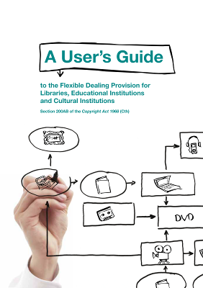
library and archive exceptions
Usually only allow access in response to user request
Online access generally only permitted onsite and for particular material (eg manuscripts)
s200AB – has the potential to allow some proactive access (eg of orphaned works, special collections, original material)
But this isn’t the end of the story
You can be more creative with ‘low hanging fruit’ eg public domain material, your material, material you have permission to use, open content
http://www.digital.org.au/alcc/resources/
CRICOS No. 00213J
Notes:
The open access movement is in a better place than its ever been before, as far as gaining ‘mainstream’ acceptance and being adopted by large players
There have, of late, been lots of official statements endorsing open access – from the OECD, from Venturous Australia etc

Slide 13
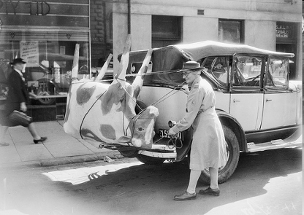
public domain material
Some films and most photographs before 1955; other materials if author died before 1955.
Can do anything you want without asking extra permission (even if the donor doesn’t like it)
Can be re-used from archive website without the archive’s permission (even if archive/donor doesn’t like it)
A papier-mache cow on Mrs Mellor’s car, 1944, Herald Newspaper, Australian War Memorial collection, No known copyright restrictions http://farm4.static.flickr.com/3384/3527160566_2d32b2cb45.jpg
Watch out for . . .
Underlying works that are still in copyright (eg script, background music)
Risk averse policies – that require absolute proof of public domain status
CRICOS No. 00213J
Notes:
The open access movement is in a better place than its ever been before, as far as gaining ‘mainstream’ acceptance and being adopted by large players
There have, of late, been lots of official statements endorsing open access – from the OECD, from Venturous Australia etc

Slide 14
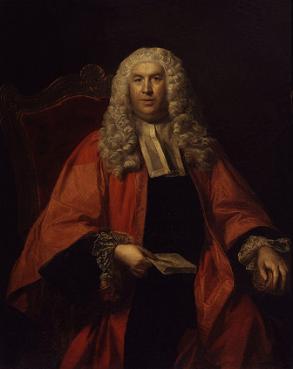
object v copyright
Ownership of object =/ right to prevent copying
Donor agreements – probably (though don’t definitely) bind the institutions, don’t bind downstream users (they aren’t privy)
Website terms of use – probably not effective to restrict use of public domain works in Australia (and bad practice)
Reproductions – debatable whether separate copyright applies to mere reproductions of public domain material in Australia. Might in the UK, definitely not in the US and most of EU
Sir William Blackstone, by unknown artist, National Portrait Gallery, UK, public domain [?] http://upload.wikimedia.org/wikipedia/
commons/6/6d/Sir_William_Blackstone_from_NPG.jpg
CRICOS No. 00213J
Notes:
The open access movement is in a better place than its ever been before, as far as gaining ‘mainstream’ acceptance and being adopted by large players
There have, of late, been lots of official statements endorsing open access – from the OECD, from Venturous Australia etc

Slide 15
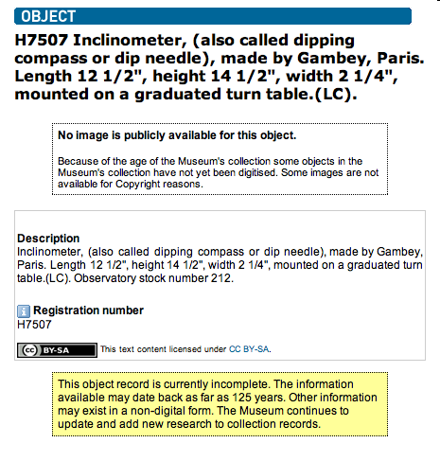
institution’s copyright
Any materials produced as part of an officer’s employment will be owned by the institution
These materials can be made available on terms of your choosing
Often institutions produce large amounts of material that isn’t monetized and can be easily licensed eg catalogue descriptions, articles, policies, educational materials
One person’s junk is another’s treasure
Watch out for. . .
Third party content
Restrictive policies – knee jerk restriction of material without good reason
Powerhouse Museum collection record http://www.powerhousemuseum.com/dmsblog/index.php/2009/04/27/another-opac-discovery-the-gambey-dip-circle-and-the-value-of-minimal-tombstone-data/
CRICOS No. 00213J
Notes:
The open access movement is in a better place than its ever been before, as far as gaining ‘mainstream’ acceptance and being adopted by large players
There have, of late, been lots of official statements endorsing open access – from the OECD, from Venturous Australia etc

Slide 16
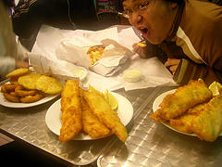
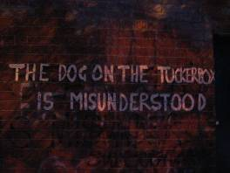
with permission
you can do anything if you have the copyright owner’s permission – including though open content licences
though permission sometimes seems an insurmountable barrier (orphaned works), it can be easier for certain materials – eg new donations, material produced as part of library initiatives (eg digital storytelling), material with a single identifiable copyright owner
giving copyright owners the option of broader licensing can have positive results
:/ - http://www.flickr.com/photos/angelltsang/30211494/
Watch out for . . .
Copyright infringement in third party materials
Broken Simulacra - http://www.flickr.com/photos/broken_simulacra/91355505/
CRICOS No. 00213J
Notes:
The open access movement is in a better place than its ever been before, as far as gaining ‘mainstream’ acceptance and being adopted by large players
There have, of late, been lots of official statements endorsing open access – from the OECD, from Venturous Australia etc

Slide 17
what can/must collecting institutions do with Wikimedia?
CRICOS No. 00213J

Slide 18


Wikimedia material
Text on Wikimedia projects dual licensed under:
  GNU Free Documentation Licence (GFDL); and
  Creative Commons Attribution-ShareAlike licence (BY-SA) (recent addition, now dominant)
Can use text under either licence - very similar, though GFDL has more technical requirements
Other material (eg photos) can vary – but must be free licensed, public domain or used under limited ‘fair use’ policy
Has strict copyright compliance policies – moderator enforced
CRICOS No. 00213J
Notes:
The open access movement is in a better place than its ever been before, as far as gaining ‘mainstream’ acceptance and being adopted by large players
There have, of late, been lots of official statements endorsing open access – from the OECD, from Venturous Australia etc

Slide 19
GFDL & CC BY-SA
Allow you to:
  copy, distribute, display, and publicly perform all or part of the work
  edit, repurpose or remix the work
  incorporate the entire work into a collection
  format shift the work (eg move to other devices)
for any purpose (including commercial)
As long as you:
  attribute the original author – for Wikimedia a link is usually enough (see CCau factsheet for more)
  license any new works you create using the material under the same licence (note – not any other ShareAlike licence)
CRICOS No. 00213J
Notes:
The open access movement is in a better place than its ever been before, as far as gaining ‘mainstream’ acceptance and being adopted by large players
There have, of late, been lots of official statements endorsing open access – from the OECD, from Venturous Australia etc

Slide 20
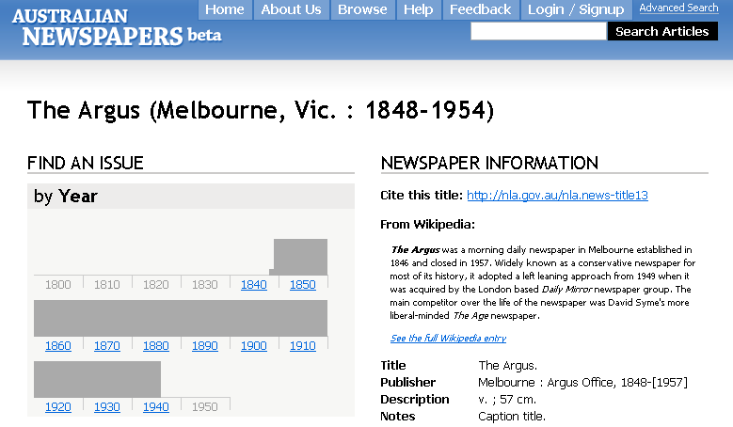
I’ll share if you share
ShareAlike/copyleft clause designed to promote free culture, ensuring material donated to the commons stays in the commons
Institutions are often reluctant to use SA material because it might ‘infect’ their works
National Library of Australia http://ndpbeta.nla.gov.au/ndp/del/title/13
SA only affects ‘derivative works’ – ie new works that are based on/incorporate the original work (eg film soundtracks, collages)
Can use SA material in ‘collection’ that merely gathers different works together without having to licence the work (eg slideshow, illustration)
CRICOS No. 00213J
Notes:
The open access movement is in a better place than its ever been before, as far as gaining ‘mainstream’ acceptance and being adopted by large players
There have, of late, been lots of official statements endorsing open access – from the OECD, from Venturous Australia etc

Slide 21
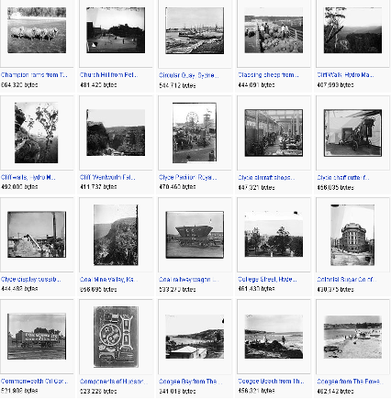
licensing your material
For material to be able to be re-used by Wikimedia, it must be licensed under a compatible licence – so can meet SA requirement
Wikimedia can’t use material that has a non-commercial limitation or licences that don’t allow changes/remixing (eg CC No Derivatives)
Compatible licences include CC BY-SA, CC Attribution, public domain (or equivalents) – NOT GFDL alone
Can’t/shouldn’t try to overrule fair dealing or require permission to link
Screenshot of Powerhouse Museum public domain photographs on Wikimedia Commons http://commons.wikimedia.org/wiki/Category:Images_from_the_Powerhouse_Museum
CRICOS No. 00213J
Notes:
The open access movement is in a better place than its ever been before, as far as gaining ‘mainstream’ acceptance and being adopted by large players
There have, of late, been lots of official statements endorsing open access – from the OECD, from Venturous Australia etc

Slide 22
final messages
You can make your collection available – just look for the easy marks
Think carefully about how you’re licensing your material and why – don’t just assume you should (or can) lock things up
Think about licensing ethics – should you restrict access?
Access adds value – something locked in a filing cabinet is no good to anyone
CRICOS No. 00213J
Notes:
The open access movement is in a better place than its ever been before, as far as gaining ‘mainstream’ acceptance and being adopted by large players
There have, of late, been lots of official statements endorsing open access – from the OECD, from Venturous Australia etc

Slide 23
Thanks
http://www.cci.edu.au
http://www.creativecommons.org.au
info@creativecommons.org.au
Unless otherwise noted, this slide show is licensed under a Creative Commons Australia Attribution licence. For more information see http://creativecommons.org/licenses/by/2.5/au/.
CRICOS No. 00213J

